Slide 1

For All Questions Contact Patrick B. Hoey
National Enterprise Acct. Manager
Konica Minolta Business Solutions U.S.A., Inc.
23 River Street Byfield, MA. 01922
Office: 978-760-2472
Mobile: 978-760-2472
EMAIL Hoeyp@KMBS.Konicaminolta.us
Notes:
The possibilities are endless. Everything we do is shaped by the promise to deliver solutions that exceed your expectations. We are Konica Minolta Business Solutions. And we give shape to ideas!

Slide 2

Global
Profile
$9.2 billion* in total revenue
160 countries, 6 continents
20 top-ranked manufacturing facilities
41,600 employees
Industry-leading R&D
* converted from JPY 1,011 billion
Notes:
Represented in sales and service in 160 countries across 6 continents
41,600 employees worldwide (approximately)
Industry leading R&D efforts (FIVE Business Innovation Centers – BICs)

Slide 3


Ingredients for Success
  Simple • Supportive • Success
3D Printing
Industry Class Print Portfolio
Label Press Portfolio
Composition and Prepress
Disruptive Finishing Technologies
S
Color Management Services
Workflow Optimization
End-to-End Job Management
Notes:
Execution – we have developed a deep understanding of how the graphic communications industry is evolving and continuously work to identify the needs of customers across the industry. By serving as trusted partners, we can help our customers with one or all three of the ingredients needed for success (technology, solutions and service). By offering all three, the Konica Minolta offers a recipe for success and growth.

Slide 4
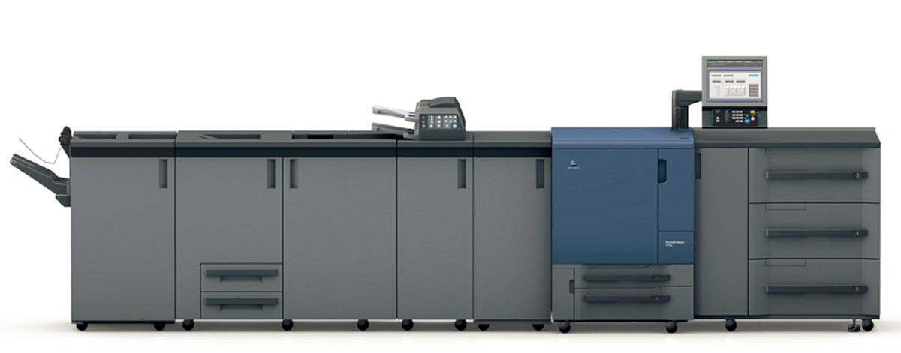

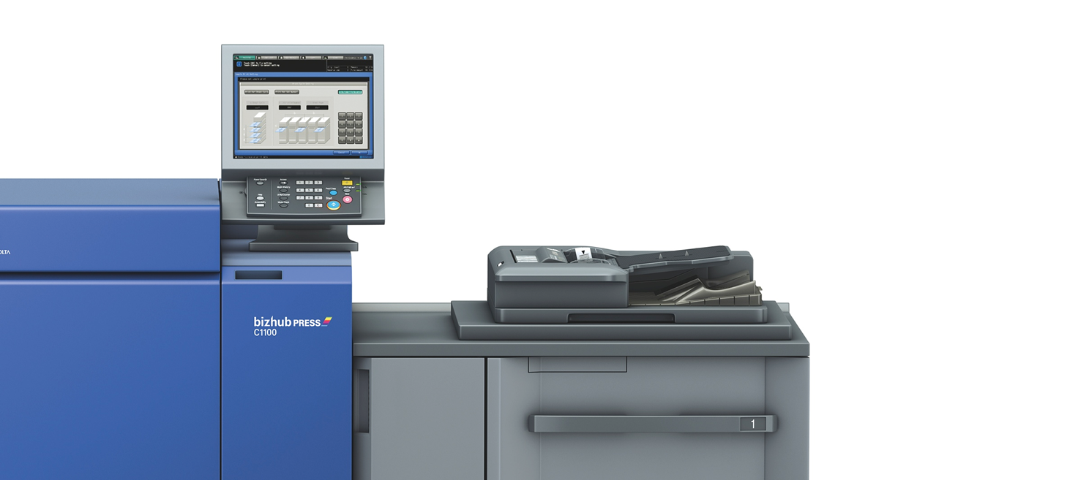

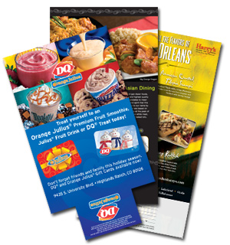
Professional Print Portfolio
  Industry-leading output, Long-running reliability
Notes:
bizhub PRESS C1100
The high-speed bizhub® PRESS C1100 sets a new standard in digital productivity, producing 5,000 or more sides per hour – save space on your production floor and reduce time and labor costs by incorporating powerful inline finishing options and simple, intuitive setup.
100ppm – FULL SPEED REGARDLESS OF SUBSTRATE TYPE/WEIGHT (55-350gsm)
NO 2nd FUSER!! (saves $$$ + 20” of floor space)
1M impression duty cycle on C1100 vs. 500K on C8000
Improved image quality
S.E.A.D. IV, Simtri HDE, Dot Position Control (DPC)
Improved: FM screen quality, outline image processing, image compression/decompression…
Best in class color stability
Up to (3) PFU’s = 9 trays for maximum paper capacity of 13,390
Bizhub C71HC High Chroma
Vivid reds, brilliant blues, natural flesh tones the bizhub PRESS C71hc brings High-chroma color to print production, achieving colors that come closer to what you see on your monitor without complex spot color adjustments, double hits and expensive inks. What you see is what you get – at a cost you can afford.

Slide 5

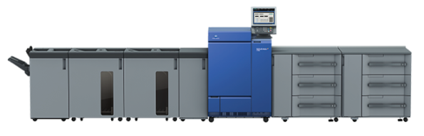
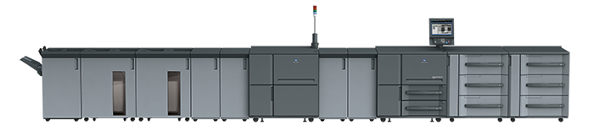
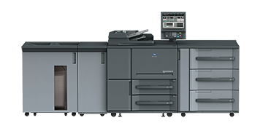
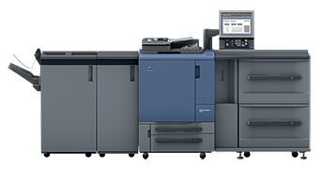
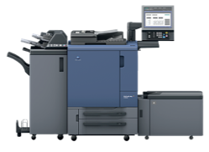
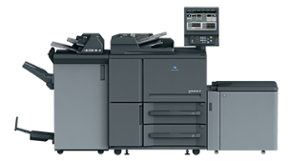


Production Print
The bizhub PRESS color and monochrome lineup is the optimal choice in markets with increased competition due
to high volume needs and decreased total print revenue.
Increased demand for higher productivity is anticipated.
bizhub PRO C6100/C6085
bizhub PRESS 2250P
HPP
Print Speed
bizhub PRESS 6120/6136
MPP
Accurio Press C3070-C3080-C3080P
bizhub PRESS 1052
Accurio Press C3070L
bizhub PRO 1100
LPP
Document Volume
Notes:
Konica Minolta bizhub PRESS and bizhub PRO equipment leads the industry in digital production print performance — with revolutionary color image quality, ultra-high-speed B&W output, pro-quality inline finishing options to meet any job specs, and purpose-built reliability to stay competitive and keep pace with rising client workloads. Buyers Laboratory LLC – 2015 Received Production PRO Picks for the PRESS 1052, PRESS 2250P and PRESS C1100

Slide 6
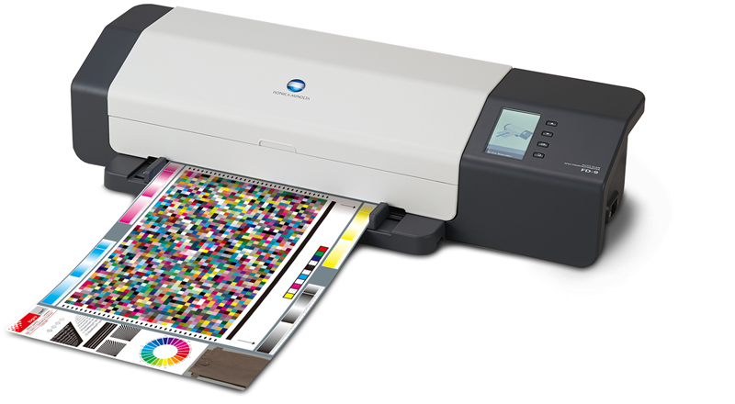
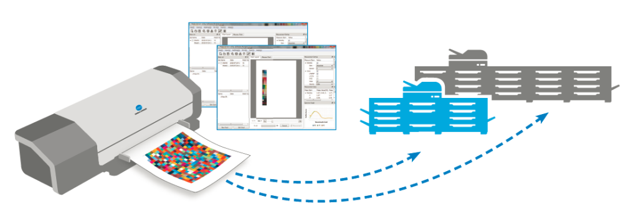
FD-9 Auto Scan Spectrophotometer
  Fast, Versatile and Connected
Industry leading color management
High Speed Spot Color Measurements
Full target scanning
No Format/Target Restrictions
Measurement Utility Software
Use with Multiple Devices
Auto sheet feeder
Notes:
The FD-9 Auto Scanning Spectrophotometer is revolutionizing the color management industry
With the FD-9 we are providing:
Industry leading color management
High Speed Spot Color Measurements
Full sheet target scanning
Fast and Hassle-free
No Format/Target Restrictions
Measurement Utility Software
Use with Multiple Devices
Auto sheet feeder

Slide 7


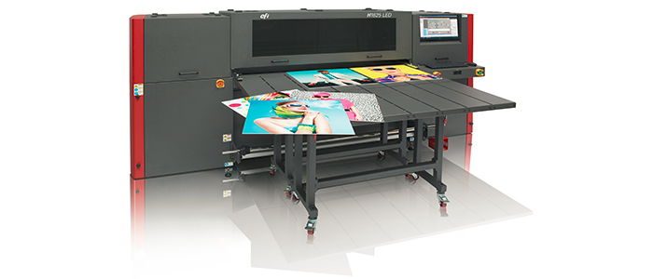
Wide Format Solutions
  Signage
  EFI H1625 / EFI H2000
  Prints four color plus white on an extended range of flexible and rigid substrates
  Near photographic image quality, saturated colors and smooth color gradations with true eight-level variable drop grayscale print capability to increase your customer satisfaction
  Ease of use & maintenance
  LED Lamp Technology
  Low operating cost
Notes:
Konica Minolta has entered the label and tag printing short run marketplace with an exciting new roll to roll product, the Bizhub Press C71cf
With a full color, mid-volume digital print solution for short run label production the Bizhub 71cf you are now capable of printing 2000 labels in less than 20 minutes.

Slide 8

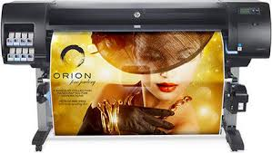

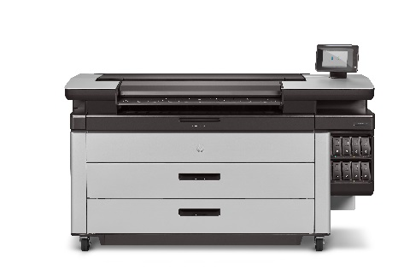
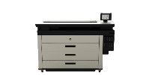
Wide Format Solutions
  Reprographics/Poster Printing
DesignJet z6800
  Full line of HP DesignJet and PageWide XL Technology
  From 12 color Photo Production to the highest quality 4 color technical device at the highest speeds available on the market.
  HP Pagewide is the most cost effective device on the market allowing customers to print color for virtually the same price as black and white.
  Ease of use & maintenance
  Zero warm up time / Low operating cost
  Never Stop on the XL – Hot Swap Inks
XL 4500
XL 4000
XL 5000
XL 8000
Notes:
Konica Minolta has entered the label and tag printing short run marketplace with an exciting new roll to roll product, the Bizhub Press C71cf
With a full color, mid-volume digital print solution for short run label production the Bizhub 71cf you are now capable of printing 2000 labels in less than 20 minutes.

Slide 9


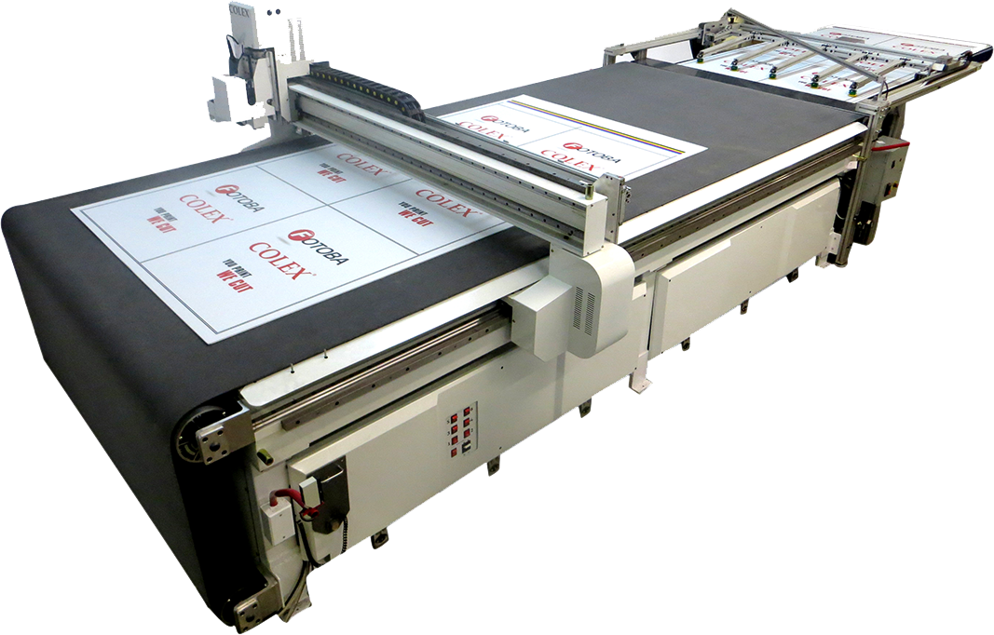
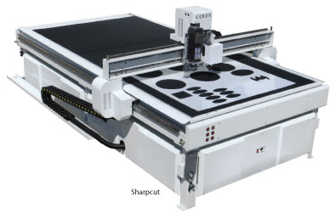

Wide Format Solutions
  Digital Flatbed Cutting Systems
Konica Minolta Represents the full line of COLEX Flatbed Cutting Systems.
POP Displays
Create Custom Boxes
Routing
Kiss cutting for Vinyl Banners and Wall Graphics
New Conveyor System & Board Feeder
Base Model 5’ x 10’

Slide 10
Wide Format Solutions
  Media Flexibility
Hard Plastics
Acrylic
Plexiglass
Diebond
Alumipanel
Styrene
Various Other Substrates
Corrugated
Paper
Chipboard
Cardstock
Honeycomb
Self Adhesive Vinyl
Diamond Grade Vinyl
Crezone
MDF
Plywood
Magnet
Falcon Board
Aluminum
Di Bond Coroplast
Foam PVC (Sintra)
Foam Core Acrylic
Soft Plastics
Coroplast
Foam PVC (Sintra)
Foam Core Acrylic

Slide 11


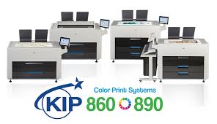
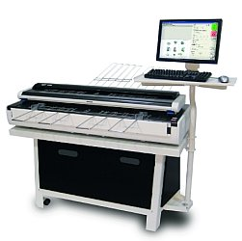
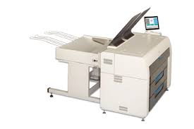
Wide Format Solutions
  Reprographics and Posters
  We represent the full line of KIP Wide Format devices
  The 800 Series provides exceptional toner based color.
  Low Cost of Operation
  Ease of use & maintenance
  The black and white products provide some of the best line quality in the industry.
  Scanners that are second to none.
KIP 7970
KIP 2300 Scanner
Notes:
Konica Minolta has entered the label and tag printing short run marketplace with an exciting new roll to roll product, the Bizhub Press C71cf
With a full color, mid-volume digital print solution for short run label production the Bizhub 71cf you are now capable of printing 2000 labels in less than 20 minutes.

Slide 12


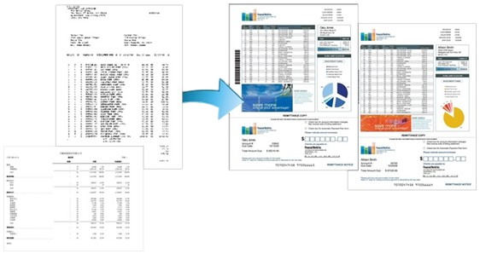

Composition and Prepress
  A Critical Step to the Workflow Process
  File Sharing and Collaboration
  Easy Document Preparation
  Variable Data Printing
  G7 Color Management
Notes:
Getting the print job set up and to the printer is critical to the workflow process. Our solutions optimize your workflow and keeps everything running smoothly and efficient.
File Sharing and Collaboration – our FileAssist solution is powerful, easy to use, secure content management system to instantly store, share, track and revise backup files online. (cloud storage)
Document Preparation Made Easy - capability to preview, modify, touch-up, layout, insert tabs, insert header/footer and perfect bind cover page creation all at once!
Variable Data Printing – provides customized documents and turns every communication into an opportunity to build loyalty
G7 Color Management – Color Master training and testing along with implementation of state-of-the-art software, helps manage color consistency across the production floor and across facilities.

Slide 13
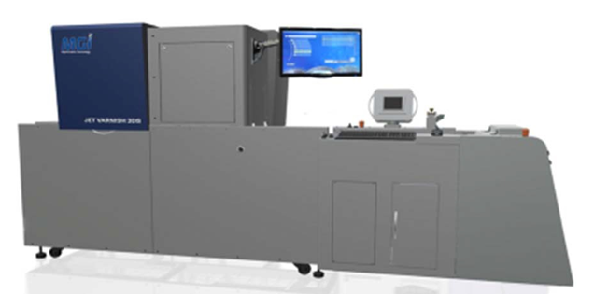
Disruptive New 3D Tactile Varnish Finish Technology
  JV3DS is designed exclusively for Konica Minolta
Offline Digital Solution for Spot UV Coating and Unique 3D Embossed Spot UV Coating
Utilizes UV Inkjet Technology
Designed for Digital Printers
Environmentally Friendly (no ozone, low heat)
  MGI JETVarnish 3DS
Notes:
The JetVarnish 3DS was designed and manufactured by MGI and Konica Minolta to help printers expand their services to include new, amazing spot UV and 3D tactile varnishing capabilities with powerful inkjet productivity and efficiency benefits.
It can turn regular print jobs into high-margin spot UV jobs, or even higher margin 3D embossed jobs. Additionally, foiling and variable foiling is now available. Industry standard foils can be used – no special added inks or media.
The JETVarnish 3DS has production speeds up to 3,000 sheets per hour based on 30 micron coating thickness. With the ability to varnish up to 100 microns (and optionally 200 microns, for 3D raised effects and tactile finishes, it can transform 2D flat surfaces into textured sensory experiences.
Utilizes UV inkjet technology – providing high impact 3D clear coating to specific areas of print
Designed for Digital Printers – easy to handle and operate
Utilizes LED curing– no ozone, low heat
Automatic Cleaning System – reduces operational maintenance

Slide 14

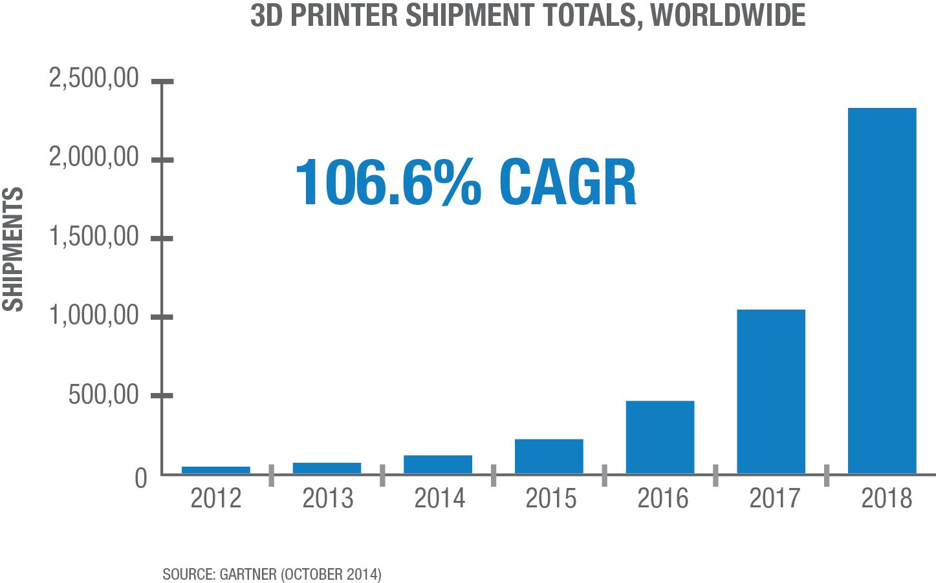
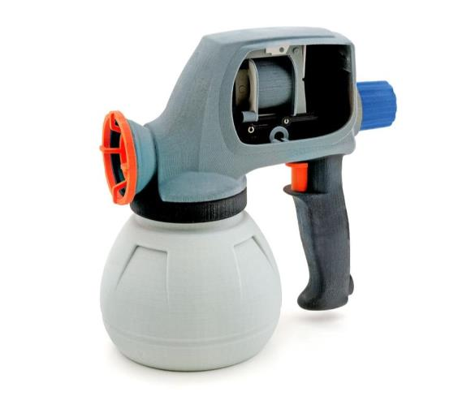


3D Printing and Services
  Consultative approach to target new market-share opportunities
SaaS Solution - 2D to 3D Print Software Automation
3D Fulfillment Services
Market 3D to your clients without any upfront investment
Notes:
By helping with every aspect of business planning, marketing strategy and sales training, the consultative approach identifies new areas of expertise that lead to new service offerings, generating additional revenue streams for you, our customer
One example is:
ProJet 660Pro 3D Printer
Full Color Printing - Largest full color parts possible, no changing materials or slowing build times
Highest Throughput - Produce multiple models in a single build by stacking and nesting parts
Fastest print speed - Quicker iterations, faster time to market, test more ideas
Affordable - $2.50-$10/cubic inch, parts cost adjusts to your needs
Easy to Use - Requires minimal training and no expertise to operate
SaaS Solution - 2D to 3D Print Software Automation
3D fulfillment services
Market 3D to your clients without any upfront investment
Additionally, in order to ease into the 3D printing market, consider outsourcing 3D production to Zverse, or just use their 2D-3D print software to better utilize your 3D device.
Zverse is a leader in 2D to 3D print software automation, design services and fulfillment solutions for 3D printed products.
The 2D to 3D SaaS solution makes 3D printing accessible for small businesses, corporations, advertising firms and promotional product companies around the world to monetize 3D Printing.

Slide 15
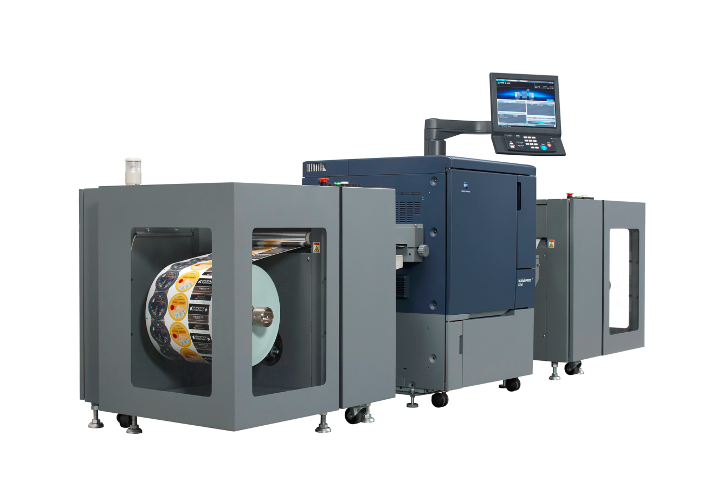
Digital Label Press
  Short run digital label production
  High speed short run labels
  Quick prototyping and product development
  Superior color management
  Ease of use & maintenance
  Lightfast imaging
  Continuous Banner Printing
  Low operating cost
Notes:
Konica Minolta has entered the label and tag printing short run marketplace with an exciting new roll to roll product, the Bizhub Press C71cf
With a full color, mid-volume digital print solution for short run label production the Bizhub 71cf you are now capable of printing 2000 labels in less than 20 minutes.

Slide 16

Customer Experience
Notes:
Konica Minolta invests the time to fully understanding the business challenges and needs of our customers – not just focusing on what will solve your problems today and tomorrow – but focusing on future potential!

Slide 17

Investing in Future Growth
  Working together to achieve new business goal

Slide 18
Service Support
  Expert technical staff
  Standardized training and education
  Advanced methods and technologies
  Integrated remote capabilities
  Sophisticated planning systems
  Skilled and certified service technicians
  Regular evaluation of service performance
  Solution Implementation Methodology (SIM)
  Engagement and Deployment strategy
Notes:
Konica Minolta delivers services and distributes products, systems and solutions that fulfill the requirements of office and production printing over the entire document life cycle. Our services range from desktop to production print products and integrated software solutions. The complete solution based offering is designed to work seamlessly with our customer’s business processes.
PLEDGE OF EXCELLENCE – We are committed to providing every customer with unmatched service, respect and integrity in every aspect of our business.

Slide 19
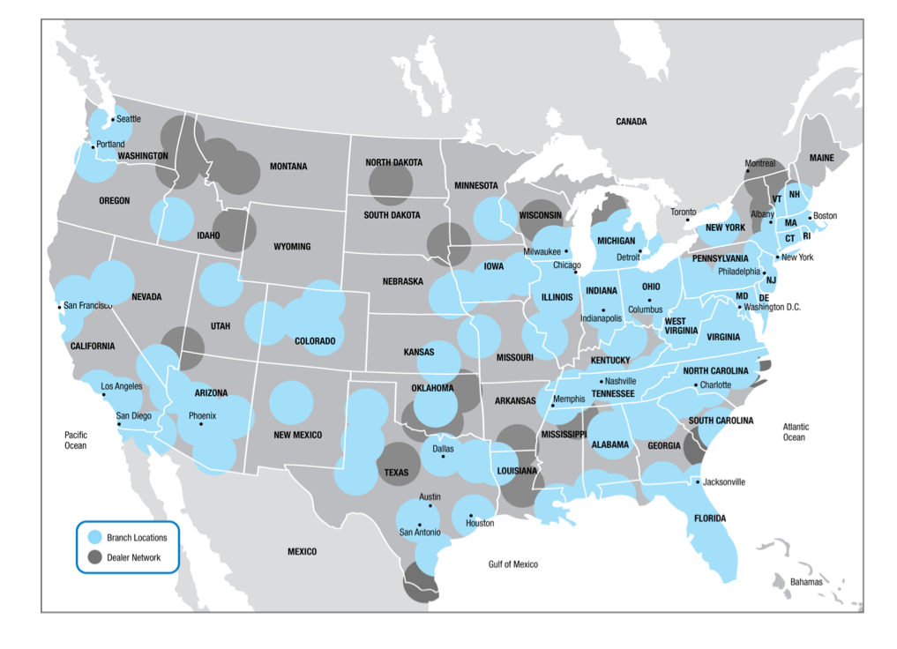
Service Coverage
KMBS Direct service capability through established branch location
Supplemental coverage via authorized
dealer network
2,400 service technical staff
in the field
Notes:
Konica Minolta has an established nationwide service program that is effective, simple to manage and efficient in delivering comprehensive service.
Our service model ensures that our customers receive the same high level of service, compliant with Konica Minolta’s prescribed standards, consistently across all locations
Fully supported system with:
125 Direct Branch Offices
350 Authorized Dealers nationwide

Slide 20
Fast, Reliable, Targeted
Customer Portal
Equipment Detail
Order and Track Supplies
Schedule Service
Enter Meter Reads
Pay Invoices
Fleet Reporting
MyKMBS.com
Notes:
MyKMBS.com makes managing your fleet quick and easy.
A complete and comprehensive, online service management website that will provide you with the capability to perform valuable functions, including placing service calls, ordering supplies, entering meter reads, and even paying invoices. Your site can also be personalized.
SAP functionality for transaction management
Site can be extended through XML web-service architecture to integrate with your systems!
1(800) 456-5664
Automated for after-hours calls.

Slide 21







Industry Recognition
  Ongoing Pursuit for Excellence
Notes:
Brand Key – Customer Loyalty Engagement Index
#1 Brand for Customer Loyalty MFP Office Copier Category for Ninth (9th) Straight Year
Dow Jones Sustainability World Index - Named for economic, environmental and social performance.
DJSI World - fourth consecutive year
DJSI Asia Pacific - seventh consecutive year
FTSE Group Best known indices in the world for socially responsible investment (SRI) communities. Included in the FTSE4Good Global Index – 12th consecutive year
BLI 2016 Winter Picks – Awarded BLI 2016 Winter Picks for Outstanding 21-30ppm A3 Monochrome MFP (bizhub 287) & Outstanding 21-40ppm A3 Color MFP (bizhub C368): products considered “best in class”!
BLI 2016 Outstanding Achievement - Awarded BLI 2016 Winter Pick for Outstanding Achievement in Innovation: The bizhub MarketPlace Chameleon Feature Set, available as part of the bizhub MarketPlace MFP app store.
Hyland Software - Received Diamond & Platinum Support Award honors in 2016 for helping organizations operate more efficiently using the OnBase® enterprise content management (ECM) solution.
AllCovered - Recognized as one of the top Managed IT service providers for sixth consecutive year! Named to the MSPmentor501 list as well as to CRN’s
Managed Service Provider Elite 150

Slide 22

Thank You! Questions?
Notes:
The possibilities are endless. Everything we do is shaped by the promise to deliver solutions that exceed your expectations. We are Konica Minolta Business Solutions. And we give shape to ideas!

